Slide 1
PLANTING A FALL GARDEN
Barbara Billek
Columbia West Side Gardener

Slide 2
WHY
WHAT
WHEN
WHERE
HOW

Slide 3
WHY
WATER IS AT THE SITE
SECOND OPPORTUNITY
JUMP ON THE SPRING
WEATHER
WEEDS AND INSECTS

Slide 4
WHAT

Slide 5
CRUCIFEROUS FAMILY
ARUGULA
BOK CHOY
BROCCOLI
BRUSSELS SPROUTS
CABBAGE
CAULIFLOWER
COLLARDS
KALE
KOHLRABI
MUSTARD GREENS
PARSNIPS
RADISH
RUTABAGA
TURNIPS
WATERCRESS

Slide 6
ALLIUM FAMILY
GARLIC
SHALLOTS

Slide 7
BEETROOT FAMILY
BEETS
SWISS CHARD
SPINACH

Slide 8
CARROTS
LETTUCE
PEAS

Slide 9
YES, 23 DIFFERENT VEGETABLES

Slide 10
WHEN

Slide 11
WHEN CAN YOU PLANT
UNIVERSITY OF MARYLAND EXTENSION SERVICE PUBLICATION #HG16
THERE IS A LINK TO THIS ON THE COLUMBIA GARDENERS WEBSITE

Slide 12
LIST THE VEGETABLES YOU WANT TO PLANT
LIST THEIR PLANTING DATES
ARRANGE THEM IN CHRONOLOGICAL ORDER

Slide 13
Fall Planting Dates
6/15 – 8/1 CARROTS
6/15 – 7/25 CHARD
6/20 – 8/1 BEETS
7/10 - 8/10 KALE
7/10 – 9/1 TURNIPS
7/15 – 9/1 LEAF LETTUCE
7/20 – 8/20 BROCCOLI PLANTS
7/25 – 8/5 PEAS
8/1 – 9/5 SPINACH AND ARUGULA
10/15- 11/15 GARLIC AND SHALLOTS

Slide 14
SOIL TEMPERATURE MAP
www.greencastonline.com
CLICK ON AGRONOMIC TOOLS
CHOOSE FROM THE DROP DOWN MENU

Slide 16
SOIL TEMPERATURE
www.aces.edu – PUBLICATION #ANR-1061
1. MINIMUM TEMPERATURE
2. OPTIMUM RANGE
3. OPTIMUM TEMPERATURE
4. MAXIMUM TEMPERATURE

Slide 17
SOIL TEMPERATURE
www.heirloomseeds.com
NUMBER OF DAYS FOR VEGETABLE SEEDS TO
EMERGE AT DIFFERENT TEMPERATURES

Slide 18
WHERE

Slide 19
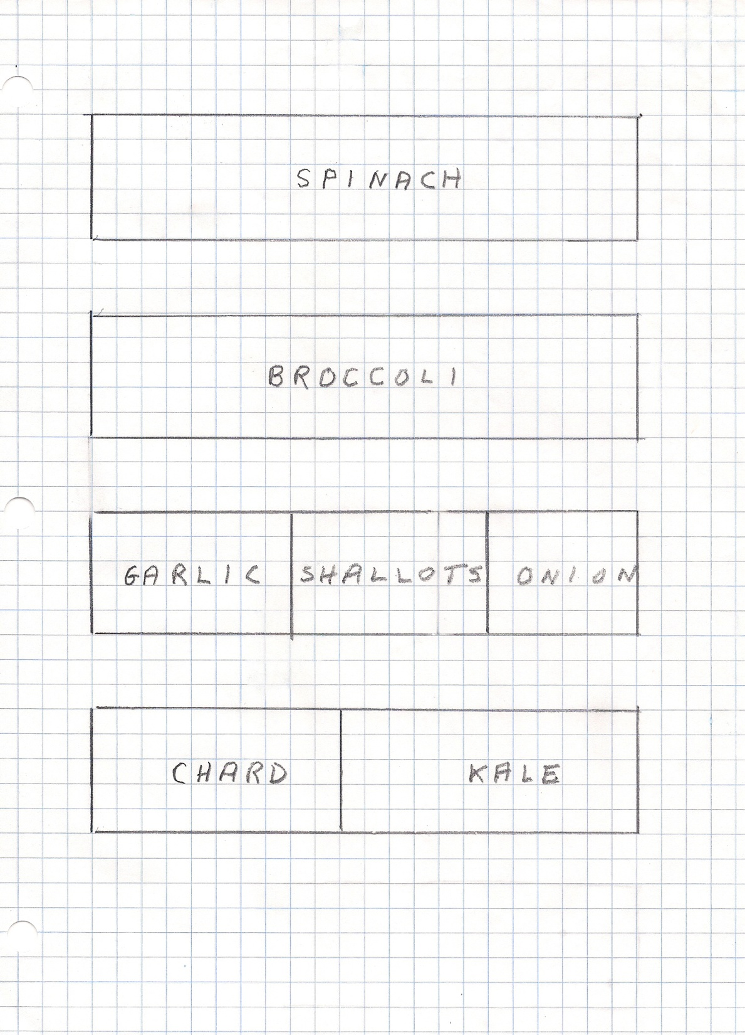

Slide 20
NOW YOU KNOW
WHY YOU SHOULD PLANT A FALL GARDEN
WHAT CROPS YOU CAN GROW
WHEN YOU CAN PLANT EACH CROP
WHERE YOU CAN PLANT THEM

Slide 21
HOW

Slide 22
SOME THINGS TO CONSIDER

Slide 23
LIGHT AND HARD FROSTS
FROSTS ACTUALLY IMPROVE THE FLAVOR AND SWEETEN MEMBERS OF THE CRUCIFEROUS FAMILY
HARDY CROPS WILL CONTINUE TO GROW UNTIL TEMPERATURES DROP INTO THE TWENTIES

Slide 24
HOW TO DEAL WITH FROSTS

Slide 25
USE A FLOATING ROW COVER

Slide 26
UNIVERSITY OF MARYLAND EXTENSION SERVICE
PUBLICATION # GE004:
“FLOATING ROW COVER”
THERE IS A LINK TO THIS PUBLICATION ON THE COLUMBIA GARDENERS WEBSITE

Slide 27
ADVANTAGES
CAN SOW SEEDS LATER IN THE FALL – FROST PROTECTION
MORE RAPID GROWTH
KEEPS INSECTS OFF OF YOUR PLANTS
WEEDS ARE HINDERED FROM SOWING THEIR SEEDS
DISCOURAGES DEER AND OTHER ANIMALS
AIR, SUN AND WATER CAN PENETRATE

Slide 28
THERE ARE DIFFERENT GRADES OF ROW COVER

Slide 29
FOR FALL PLANTING
USE THE GRADE THAT PROTECTS DOWN TO 28 DEGREES

Slide 30
DIFFERENT SIZES

Slide 31
WHERE CAN YOU PURCHASE FLOATING ROW COVER
AT SEED AND GARDEN SUPPLY COMPANIES ON LINE
LOCAL GARDEN SUPPLY STORE

Slide 32
IN CONCLUSION - FOR A FALL GARDEN
YOU NEED ROW COVER TO KEEP YOUR PLANTS WARM
PURCHASE SEEDS IN THE SPRING SINCE THEY MAY NOT BE AVAILABLE IN THE FALL

Slide 33
PICTURES

Slide 34
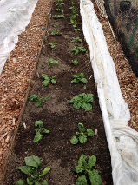

Slide 35
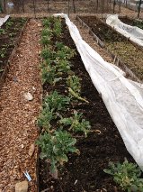

Slide 36
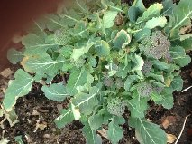

Slide 37
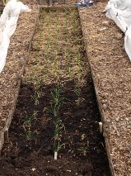

Slide 38
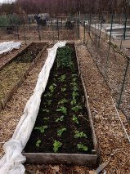

Slide 39
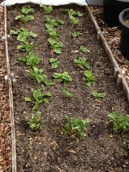

Slide 40
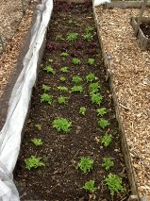

Slide 41
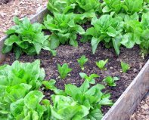

Slide 42
IF YOU PLANT A FALL GARDEN
YOU COULD BE HARVESTING IN MARCH
WHILE OTHERS ARE WEEDING, SOWING AND
HARVESTING IN MAY

Slide 43
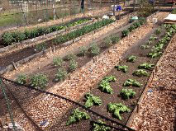
MY GARDEN ON APRIL 13, 2013

Slide 44
Thank You
AND HAPPY FALL GARDENING

